Slide 1
Network Intrusion Detection
By :
Shahad Alomayrah

Slide 2
01
04
02
05
03
06
Overview
EDA
Dataset
Classification algorithms
Data Preprocessing
Confusion matrix

Slide 3
Overview
The issue Network intrusion detection is an important and sensitive issue when it comes to the privacy of organizations and individuals, especially when transmitting important and sensitive information

Slide 4
DataSet
Collected the data from Kaggle website
2938 Columns
22 Rows
.

Slide 5
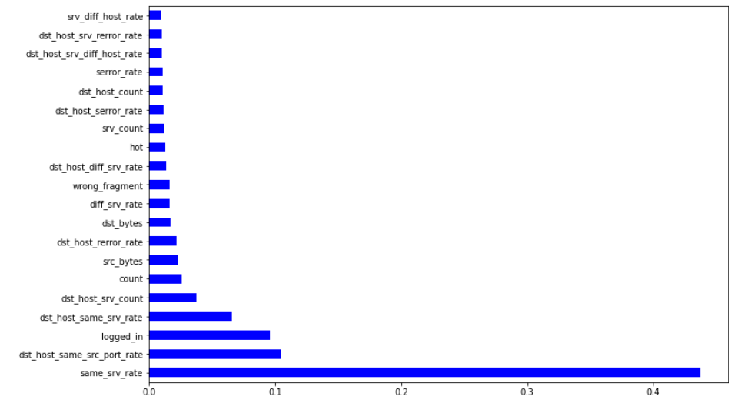
Feature Importance

Slide 6
Data Preprocessing
Feature Selection
check duplicat
Label Encoding
rename column
Scaler

Slide 7
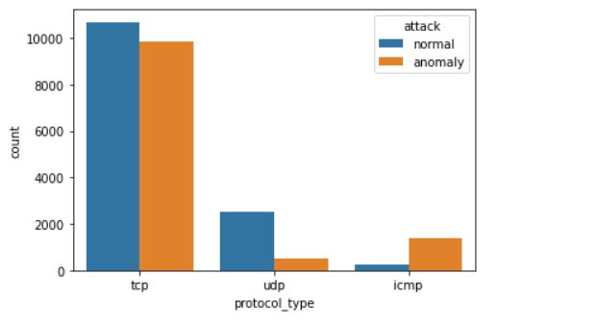
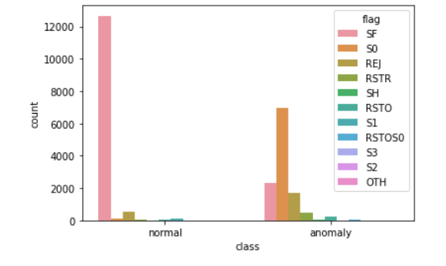
EDA
Protocol safer TCP and the most protocol that happens in it anomaly UDP
The safer is flag SE

Slide 8
Experiments - Results
Model
Training
Test
F1-Score
Logistic Regression | 0.94 | 0.94 | 0.95
KNN | 0.63 | 0.62 | 0.67
Decision Trees | 0.97 | 0.97 | 0.97
Random forest | 0.99 | 0.99 | 0.99
XGBoost | 0.99 | 0.99 | 0.99

Slide 9
Experiments - Results
Model
Training
Test
F1-Score
Grid Search Random Forest | 0.99 | 0.99 | 0.99
Grid Search KNN | 0.98 | 0.97 | 0.98
Grid Search Logistic Regression | 0.87 | 0.87 | 0.88

Slide 10
Experiments - Results
Model
Training
Test
Bagging | 0.87 | 0.86
Hard Voting | 0.99 | 0.99
Confusion matrix of Best Model

Slide 11
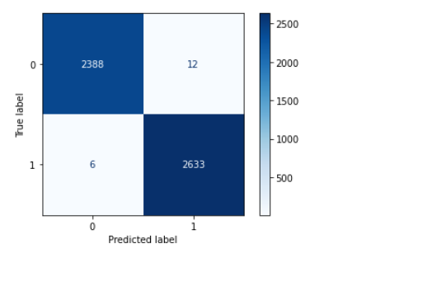
Confusion matrix of Best Model
Random forest

Slide 12
THANKS!
Do you have any questions?

